Slide 1

Introduction to Research Data Management Using Globus
Rick Wagner
rick@globus.org University of Chicago
Argonne National Laboratory
SDSC Summer Institute 2018 – Aug 10, 2018

Slide 2

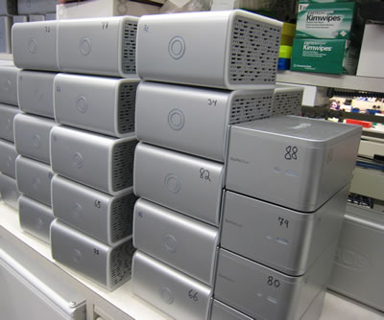
Research data management today
Index?
How do we...
...move?
...share?
...discover?
...reproduce?

Slide 3
Globus delivers… Secure, reliable, data transfer, sharing, publication, and discovery… …directly from your own storage systems… ...via software-as-a-service

Slide 4
Globus enables...
Campus Bridging
…within and beyond campus boundaries

Slide 5


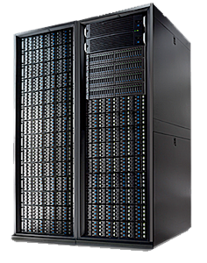
Bridge to campus HPC
Move datasets to campus research computing center
Move results to laptop, department, lab, …

Slide 6

Bridge to national cyberinfrastructure
Move datasets to supercomputer, national facility
Move results to campus (…)

Slide 7

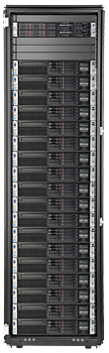
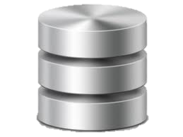
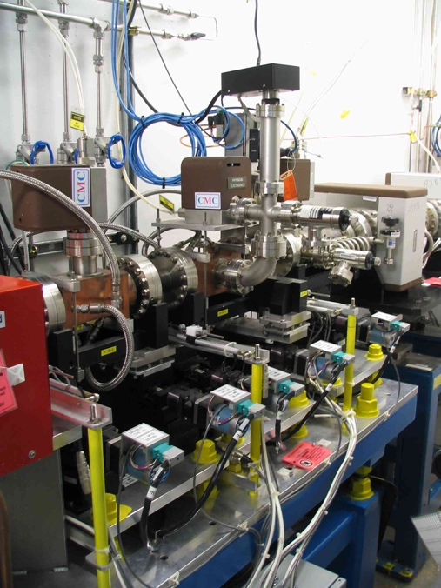

Bridge to instruments
Pre-processed Data
Analysis store
Amazon Glacier
Raw
Source
Data
High durability,
low cost store

Slide 8
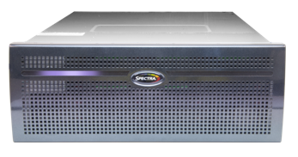

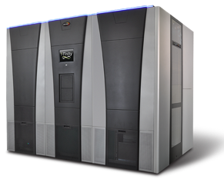







Bridge to collaborators
External
Campus
Storage
EC2
Public/Private Cloud stores

Slide 9
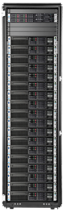




Bridge to community/public
EC2
Project Repositories,
Replication Stores
Public Repositories

Slide 10










Globus SaaS: Research data lifecycle
Compute Facility
Instrument
Globus transfers files reliably, securely
Globus controls access to shared files on existing storage; no need to move files to cloud storage!
4
2
Curator reviews and approves; data set published on campus or other system
Transfer
7
3
Share
1
Researcher selects files to share, selects user or group, and sets access permissions
6
Researcher initiates transfer request; or requested automatically by script, science gateway
Researcher assembles data set; describes it using metadata (Dublin core and domain-specific)
Publication Repository
Collaborator logs in to Globus and accesses shared files; no local account required;
download via Globus
5
Use a Web browser
Access any storage
Use an existing identity
Publish
6
8
Peers, collaborators search and discover datasets; transfer and share using Globus
Discover
Personal Computer

Slide 11
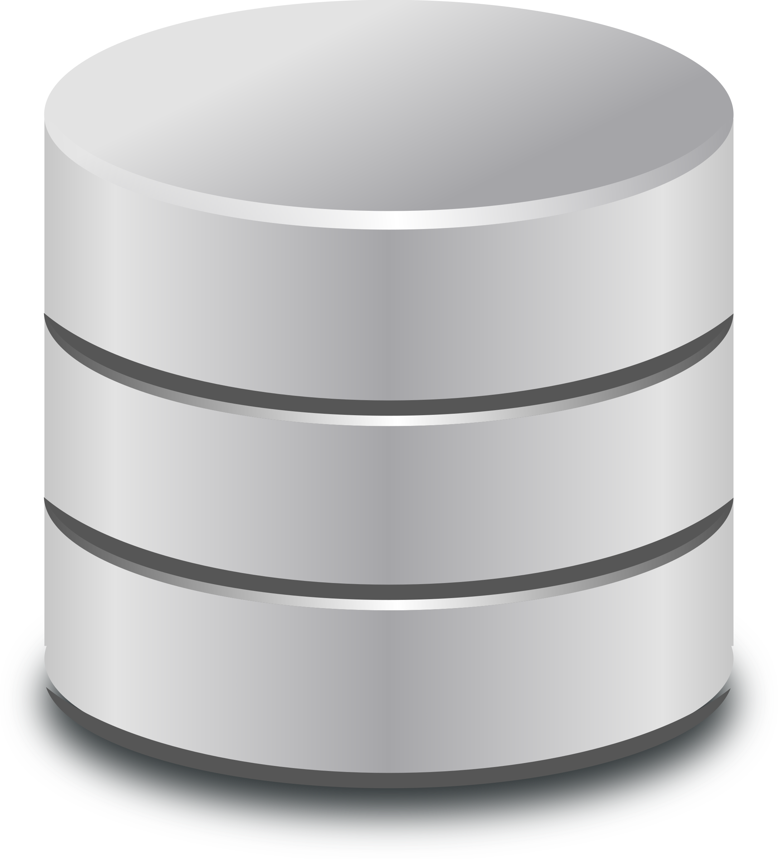


Conceptual architecture: Hybrid SaaS
Subscriber
Control
Domain
No data relay or staging via Globus
DATA
Channel
Source
Endpoint
Destination
Endpoint
Subscriber owned and administered storage system
CONTROL
Channel
Globus “client” software
Single, globally accessible multi-tenant service
Globus
Control
Domain

Slide 12

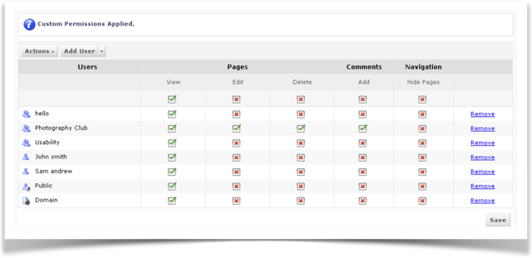
Conceptual architecture: Sharing
External User
Control
Domain
Subscriber
Control
Domain
DATA
Channel
Managed
Endpoint
CONTROL
Channel
Administrator managed filesystem permissions
Shared
Endpoint
Globus
Control
Domain
User managed ”overlay” permissions

Slide 13
Why use Globus?
Simplicity
Consistent UI across systems
Easy access to collaborators
Reliability and performance
“Fire-and-forget” file transfer
Maximized WAN throughput
Operational efficiency
Low overhead SaaS model
Highly automatable: CLI, RESTful API
Access to a large and growing community

Slide 14
Demonstration
File Transfer
File Sharing
Group Management

Slide 15
Globus data publication framework
Identifier
URL
Handle
DOI
Description
None
Standard
Domain-specific
Custom
Curation
None
Acceptance
Human-validated
Machine-validated
Access
Anonymous
Public
Embargoed
Collaborators
Preservation
Transient
Project Lifetime
Archive
“forever”

Slide 16
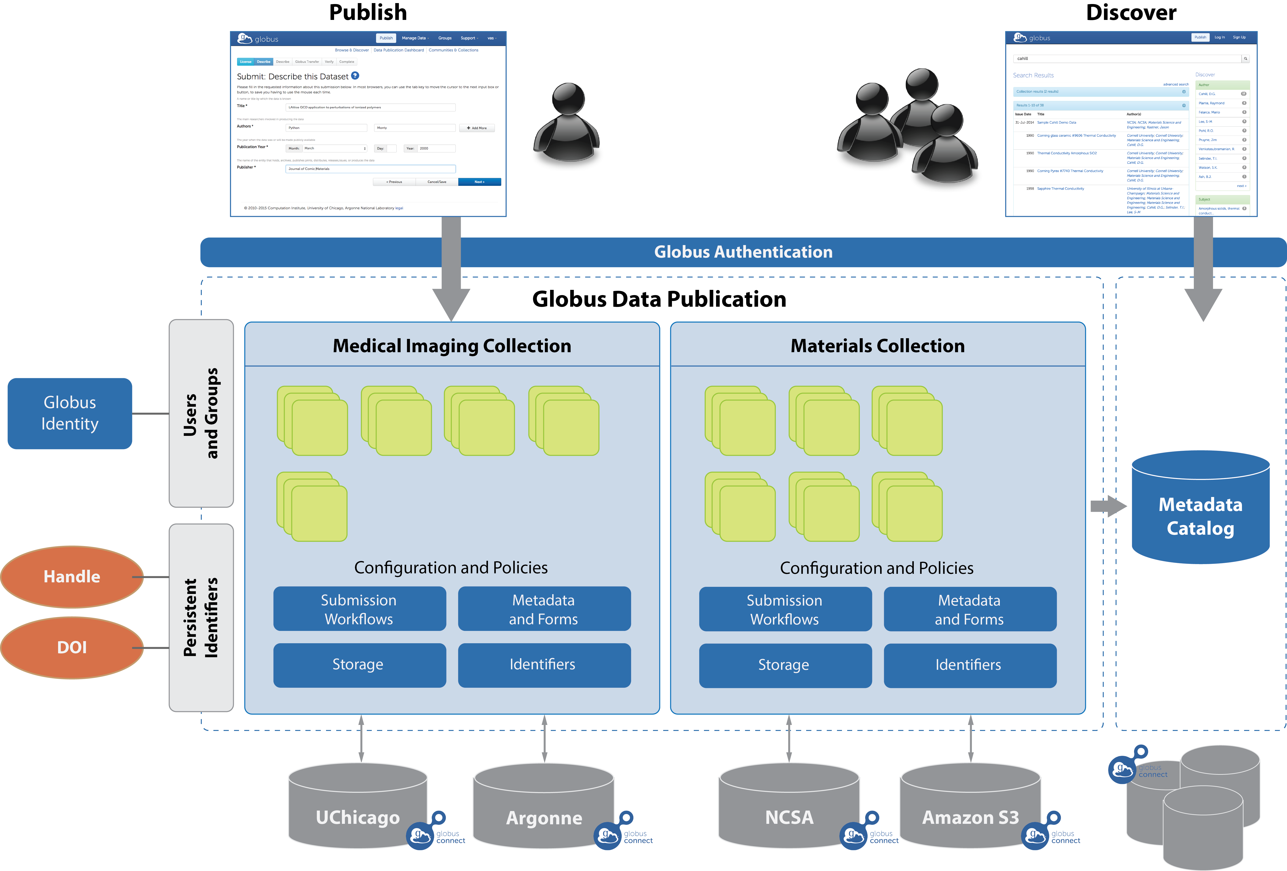

Slide 17
How can I use Globus on my computer?

Slide 18
…makes your storage system a Globus endpoint

Slide 19



Globus Connect Personal
Installers do not require admin access
Zero configuration; auto updating
Handles NATs

Slide 20
How can I integrate Globus into my research workflows?
Specifically applications I’ve developed or am planning to develop.
Notes:
WHY
Your web app is cute, but I’ve already got applications for doing research data management. It sure would be nice if I could integrate all that Globus goodness (speed, reliability, security) quickly and easily into my existing ways of doing things and future plans.

Slide 21
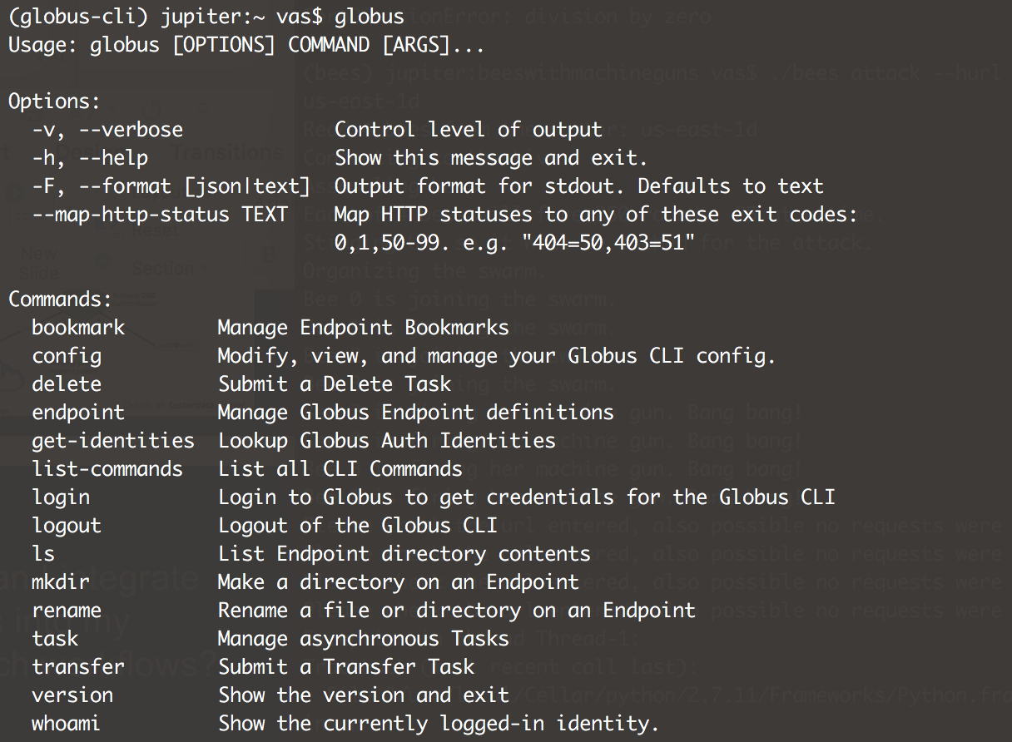
Use(r)-appropriate interfaces
Web
CLI
Globus service
GET /endpoint/go%23ep1
PUT /endpoint/vas#my_endpt
200 OK
X-Transfer-API-Version: 0.10
Content-Type: application/json
…
Rest
API

Slide 22
Globus serves as… A platform for building science gateways, portals and other web applications in support of research and education
Notes:
WHAT
We can accommodate… Globus was built by researchers for researchers. “There is always a better way to do things” is the very mantra that drives research. How could we allow you to use our foundational services to support your own applications and workflows. This is largely the theme of the day today.

Slide 23







Globus Platform-as-a-Service
Globus Transfer API
…
Globus Connect
Data Publication & Discovery
File Sharing
File Transfer & Replication
Globus Auth API
(Group Management)
Integrate file transfer and sharing capabilities into scientific web apps, portals, gateways, etc...
Use existing institutional ID systems in external web applications
Notes:
HOW
The fundamentals of the practical Globus research data management tools you’ve seen in our web app (File transfer, file sharing, data publication) are available to you through our set of APIs.
<click>
In this talk I’m going to concentrate more on the implementation of the transfer API set, that give you the ability to Integrate file transfer and sharing capabilities into scientific web apps, portals, gateways, etc.
<click>
Rachana and Steve are going to dig into Globus Auth in far more depth than I will, but I’ll touch on Globus Auth a bit in the context of the demos I’m going to do. You can’t just use the Transfer APIs at will, you have to prove who you are first and that you have the authority to do the things that you want to do.

Slide 24
PaaS Security Challenges – Globus Auth
How to provide:
Login to apps
Web apps (Jupyter Notebook, Portals), Mobile, Desktop, Command line
Protect all REST API communications
App → Globus service (Jupyter Notebook, MRDP)
App → non-Globus service (MRDP)
Service → service (MRDP)
While:
Not introducing even more identities
Providing a platform to consolidate those identities
Providing least privileges security model (consents)
Being agnostic to programming language and framework
Being web friendly
Making it easy for users and developers

Slide 25

Authorization Code Grant
Browser (User)
3. User authenticates and consents
2. Redirects user
4. Authorization code
1. Access portal
Globus Auth (Authorization Server)
5. Authenticate using client id and secret, send authorization code
Client (Jupyter Notebook, Portal, Application)
6. Access token(s)
Globus Transfer (Resource Server)
7. Authenticate with access token(s) to create a transfer client object and give the user the authority invoke the transfer service
Notes:
User attempts to access the portal (or in the case of the Jupyter Notebook) have the application access the services
Browser redirect
Local site Auth Server prompts for user name and password (if they haven’t already authenticated to Globus) and prompts for consents (the specific things it’s going to use your Globus account for) - “By clicking "Allow", you allow Insert Application Name Here, in accordance with its terms of service and privacy policy, to use the above listed information and services.”
Return to the application with an authorization code
Exchange the authorization code for
Access token(s)
Use the access token(s) to (in the case of the Jupyter Notebook) create a transfer client object
End result: All calls to the transfer service needs to have the authorization header with the transfer token.

Slide 26
Globus Platform
Transfer API

Slide 27
Globus Transfer API
Globus Web App consumes public Transfer API
Resource named by URL (standard REST approach)
Query params allow refinement (e.g., subset of fields)
Globus APIs use JSON for documents and resource representations
Requests authorized via OAuth2 access token
Authorization: Bearer asdflkqhafsdafeawk
docs.globus.org/api/transfer
Notes:
These are the same APIs that the Globus Web App uses.
All of the Globus Services expose REST APIs
All returns are in JSON format.
URL named resources – what are resources in the context of transfer
SOMEWHERE WHERE YOU TRASFER FROM OR TO: /endpoint/endpoint-uuid
SOMEHTING THAT IS HAPPENING: /task/task-uuid
Pretty standard REST approach
Globus remote operations on a resource have rough “HTTP Verb” equivalents.
Uses “patchy” PUTs – Essentially a list of modifications to the resource as opposed to a compete replacement of the resource. For example you can update only certain fields in an endpoint document by only specifying those fields.
All calls to the transfer service needs to have the authorization header with the transfer token. Talked about this in the previous slides.
Won’t go into this in too much depth as Globus Auth will be covered by Steve later, but it needs to be present in order for Transfer to work.
And you will see an instance of this when we exercise the APIs in the Jupyter Notebook.
Show the docs.globus.org site
Hierarchy broken out by functionality.
GO TO “Task Management”
Show “GET Task by ID”
URL Named Resource
Method
Response Format – Task Document

Slide 28
Globus Python SDK
Python client library for the Globus Auth and Transfer REST APIs
globus_sdk.TransferClient class handles connection management, security, framing, marshaling
from globus_sdk import TransferClient
tc = TransferClient()
globus.github.io/globus-sdk-python
Notes:
If you want to write your own clients that’s fine, but we also have an open source Python SDK in our github for both the Auth and Transfer APIs.
The Python SDK for the Transfer APIs are what we’ll concentrate on in this discussion. With some peeks back at the low level API functionality.
Basic Transfer Client Class - You’ll see this all through the SDK and examples.
Handles all of the connection management
Deals with tokens that come back from authentication
Everything required to assemble JSON documents
So when you see “tc” in the examples that’s what that is.
Go to URL
IT’s Open Source
Show it in Github repo

Slide 29
TransferClient low-level calls
Thin wrapper around REST API
post(), get(), update(), delete()
get(path, params=None, headers=None, auth=None, response_class=None)
path – path for the request, with or without leading slash
params – dict to be encoded as a query string
headers – dict of HTTP headers to add to the request
response_class – class response object, overrides the client’s default_response_class
Returns: GlobusHTTPResponse object
Notes:
There are low level calls for the TransferClient that map to the REST operations.
If Python is not your language of choice, or you REALLY want to do it yourself!
Formatting returns then up to you!
You can dig into the transfer client in the doc.

Slide 30
TransferClient higher-level calls
One method for each API resource and HTTP verb
Largely direct mapping to REST API
endpoint_search(filter_fulltext=None,
filter_scope=None,
num_results=25,
**params)
Notes:
On top of the low level calls we’ve implemented higher level helper methods for key operations.
Tried to keep it simple and have roughly one-to-one correspondence between the API and the helpers., For example “endpoint_search”, pass some parameters and the SDK pretty much does the rest.
You’ll see this in real life when we run through the Jupyter Notebook.

Slide 31
Walkthrough Jupyter Notebook
https://jupyter.demo.globus.org
Sign in with Globus
Verify the consents
Start My Server (this will take about a minute)
Open folder: globus-jupyter-notebooks
Open folder: globusWorld2018
Run SDK_autoAuth.ipynb
If you mess it up and want to “go back to the beginning”
Back down to the root folder
Run NotebookPuller.ipynb
Notes:
Fire up a notebook
Show people how to run commands and live edit code
Run the initial configuration – everything up to endpoint search
Configuration
Authentication steps
Help
Using the transfer client
As we’ve already said, the transfer client makes REST resources available via easy to use methods.
And the response is nice clean JSON
get_endpoint method gives us a wealth of information about the endpoint just like the help said it would.
Helper methods for APIs that returns lists have iterable responses, and automatically take care of paging where required:
endpoint_search(filter_scope="recently-used")
An example of a low level implementation
Can change
r["DATA"][3]["display_name"]
limit=4
Handling errors, again we make it easy for you… example
Bogus endpoint
Standard 4xx / 5xx HTTP errors
Classes of errors spit out by ex.code
BACK TO SLIDES

Slide 32
Endpoint Search
Plain text search for endpoint
Searches owner, display name, keywords, description, organization, department
Full word and prefix match
Limit search to pre-defined scopes
all, my-endpoints, recently-used, in-use, shared-by-me, shared-with-me
Returns: List of endpoint documents
Notes:
I’ve served up some appetizers – Now time for the entrée
1) You saw this in the Globus SaaS app and the CLI
2) Review the concept of an endpoint – storage abstraction (physical location + directory structure)
All endpoints are identified by a UUID.
modify search string
3) Scopes
try other scopes listed above
4) Search on all these various components that define an endpoint to return an endpoint document which includes a UUID.
Which you use in subsequent operations.
Show ENDPOINT DOCUMENT on Docs site
Search is a ranked search based on all terms individually (NOT on the entire phrase)
Really simple API designed for end users to find their campus endpoint
Will be enhancing this over time to do things like fuzzy match, etc. when we launch upgraded search functionality via Elastic Search

Slide 33
Endpoint Management
Get endpoint (by id)
Update endpoint
Create & delete (shared) endpoints
Manage endpoint servers
Notes:
Get the endpoint so you can operate on it. (Do Transfers)
get_endpoint()
other details: endpoint["public"], endpoint[”keywords"], for example
Update the endpoint document; new keywords for search strings, display names, etc…
epup = dict(keywords="Chicago")
tc.update_endpoint("49885d84-26d3-11e7-bc68-22000b9a448b", epup)
Create and delete endpoints as well as shares associated with endpoints.
Manage the server list that details the servers belonging to a specific endpoint.
Again – You’ve seen this in the SaaS app – You can do it with the API as well.
Use PATCHy PUTs
Means you can update only certain fields in an endpoint document by only specifying those fields

Slide 34
Endpoint Activation
Activating endpoint means binding a credential to an endpoint for login
Globus Connect Server endpoint that have MyProxy or MyProxy OAuth identity provider require login via web
Auto-activate
Globus Connect Personal and Shared endpoints use Globus-provided credential
Must auto-activate before any API calls to endpoints
Notes:
1) Globus endpoints must be "activated" before they can be used, which means associating a credential with the endpoint that is used for login to that endpoint. For endpoints that require activation (e.g., those with a MyProxy or MyProxy OAuth identity provider) you can activate those endpoints via the Globus website. Before performing operations against an endpoint, you should "autoactivate" the endpoint. On Globus Connect Personal and Shared endpoints, autoactivation will automatically create the necessary credentials to access the endpoint.
You’ll see in our Jupyter notebook demo where we autoactivate the endpoints using their endpoint_ids.
=================================================================
Tie this back to the activation dialog demonstrated at the beginning
Activation:
Host endpoints – I have to authenticate against a particular IdP
Get back a token/temp credential
Then use credential to act on behalf of user
SHARED endpoints:
You just authenticate to Globus service
Globus is going to shared endpoint and checking if the requesting user is authorized This check runs locally as the user who created the share
Basically this is delegating to Globus to implement fine grained access control
2) Implications for developing a portal: Shared endpoints are a lot nicer because you don’t have to deal with tokens and activation
Model is:
Before using endpoint call autoactivate
If credentials exist OK; otherwise you get back document telling you how to activate
BACK TO JUPYTER to show autoactivation
e.g. I activated an XSEDE endpoint – can go to another endpoint and Globus is smart enough to reuse that credential to autoactivate
3) Bottom line: Must auto-activate before any API calls to endpoints – We’ll make this concrete when we run through the Jupyter Notebook.

Slide 35
File operations
List directory contents (ls)
Make directory (mkdir)
Rename
Note:
Path encoding & UTF gotchas
Don’t forget to auto-activate first
Notes:
Be careful with path encoding, especially when going between Windows and Linux
We’ve tried to shield you form most of them but you may run into some issues
SHOW IN JUPYTER

Slide 36
Task submission
Asynchronous operations
Transfer
Sync level option
Delete
Get submission_id, followed by submit
Once and only once submission
Notes:
Up until now we’ve talked about synchronous tasks. Ask for something to happen, get a response.
Two types of asynchronous tasks (think jobs): Set and forget or Set and Query Status
Transfer (or sync)
Delete
Two-step process: For example the transfer task.
- STEP 1: Instantiate a data transfer object to get a subsmission_id
Add information about source and destination paths/files, etc.
Can add multiple of these source-dest pairs
STEP 2: Submit the transfer

Slide 37
Task management
Get task by id
Get task_list
Update task by id (label, deadline)
Cancel task by id
Get event list for task
Get task pause info
Notes:
After you submit an asynchronous task… There are some things you can do.
Recall the management console from the Globus SaaS app, these are the calls you would use to create your own console.
Get task by id – returns task document
Get task list – paged list of tasks submitted by the current user
Update task – label – concept of deadline - can manually adjust deadline
Cancel task
Get event list – page list o all events including errors, retries, etc…
Get task pause info - Get details about why a task is paused (or possibly about to be paused). This incudes pause rules on source and destination endpoints that affect the owner of the task.
===========================================================
Events: FAULTS and non-FAULTS (e.g. performance monitoring events)
Lists are usually limited to 10 most recent items; can be overriden
Pause info: Why task is paused or about to be paused
Provide some info about pause rules on endpoint
SHOW JUPYTER CODE
Get Task By ID
Get task list
Filter task list
Cancel task
Get event list for task

Slide 38
Bookmarks
Get list of bookmarks
Create bookmark
Get bookmark by id
Update bookmark
Delete bookmark by id
Cannot perform other operations directly on bookmarks
Requires client-side resolution
Notes:
Operations as you’d expect. All of the things you do in the SaaS app you can do with the APIs.
Key point: cannot submit tasks against bookmarks
Think of them as a side table that you can get a bookmark information and then go get the actual endpoint and operate on that
You will do one of these in the exercise shortly

Slide 39
Shared endpoints and access rules (ACLs)
Shared Endpoint – create / delete / get info / get list
Administrator role required to delegate access managers
Access manager role required to manage permission/ACLs
Operations:
Get list of access rules
Get access rule by id
Create access rule
Update access rule
Delete access rule
Notes:
ACL – Access control list. Who can access and what they can do.
Describe Access Manager role: someone who can create access rules on an endpoint
Get list of access rules
Paged list of what single identities or groups have what type of permissions to operate on what files or directories. Who / Where / What
Get access rule by id
Single instance of the above based on id.
Create access rule
Delegate access to a shared endpoint.
Update access rule
Update the permissions of existing rules. (Read only to RW)
Delete access rule
Allows you to give temporary access to a shared endpoint.
Rachana will cover this in depth in subsequent talks.

Slide 40
Management API
Allow endpoint administrators to monitor and manage all tasks with endpoint
Task API is essentially the same as for users
Information limited to what they could see locally
Cancel tasks
Pause rules
Notes:
Last Set
This set of APIs allows endpoint administrators to manage the transfers to and from their endpoints, to aid in proactive debugging of user transfers. All operations herin require the user to have either the "activity_manager" or "activity_monitor" roles on on an endpoint, and the endpoint must be marked as Managed and associated with a provider subscription.
You won’t see an example of these in the Jupyter notebooks because you will not have the right role designation on the Tutorial Endpoints, but they are well documented.
Show on Docs site: under “Advanced Endpoint Management” API
Model is: you have a managed endpoint; owner of endpoint can grant management rights to others so they can view information on, and manage pause ruels and cancel tasks

Slide 41
How can I do this in my [science gateway, data portal, web app, …]?

Slide 42
Demonstration
Modern Research Data Portal
https://docs.globus.org/modern-research-data-portal/

Slide 43

Prototypical research data portal
Identity Provider
Globus
Cloud
Globus Web Helper Pages
HTTPS
Desktop
Globus Auth
Globus Transfer
Login
Browser
Applications
Firewall
Other Services
Portal Web Server (Client)
REST
GridFTP
User’s Endpoint (optional)
Science DMZ
Portal Endpoint
Other Endpoints
Notes:
What are the pieces behind the scenes from our demo.
Portal web server
Data on an endpoint
The two can exist in two different security enclaves.
* Portal – Business Logic
Standard Firewall with stateful packet inspection.
* Data – housed separately, perhaps on multiple endpoints.
Science DMZ – Network architecture that enables GridFTP to work at it’s maximum potential.
Where stateful packet inspection provides no benefit.
Other Services - Could be in different domains (In our example this was the Graphing Service)
Globus Cloud
- Auth
- Transfer
- Helper Pages
Public APIs / leverage able UI
Identity provider in a completely separate domain – Depends on institution.
From a user perspective
Browser / UI
Could also have client applications that act access the Globus cloud via the same APIs
User Endpoint – Globus Connect Personal – Endpoint on your personal laptop or desktop
Binaries for Win / Mac /Linux
Similar to a Dropbox / Google drive agent – runs in background
Connections
Basic authentication over HTTPS
All interprocess communication over REST APIs
Data flows separately via GridFTP, it doesn’t touch Globus, over a pipe tuned for data transfer.
Keeps business logic and data flow separate.
In our example:
Use the browser to hit portal.
Log in using Globus Auth.
Go to identity provider to authenticate me.
Calls out to Globus transfer to get a list of files, talks to endpoint to do an actual “ls”.
PAUSE FOR QUESTIONS

Slide 44
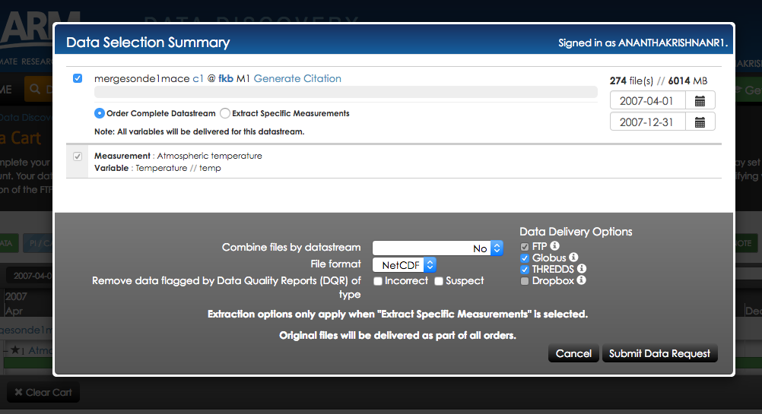
Data Distribution: ARM Climate Research Facility
Notes:
Have people actually done this in the wild? Why yes they have…

Slide 45
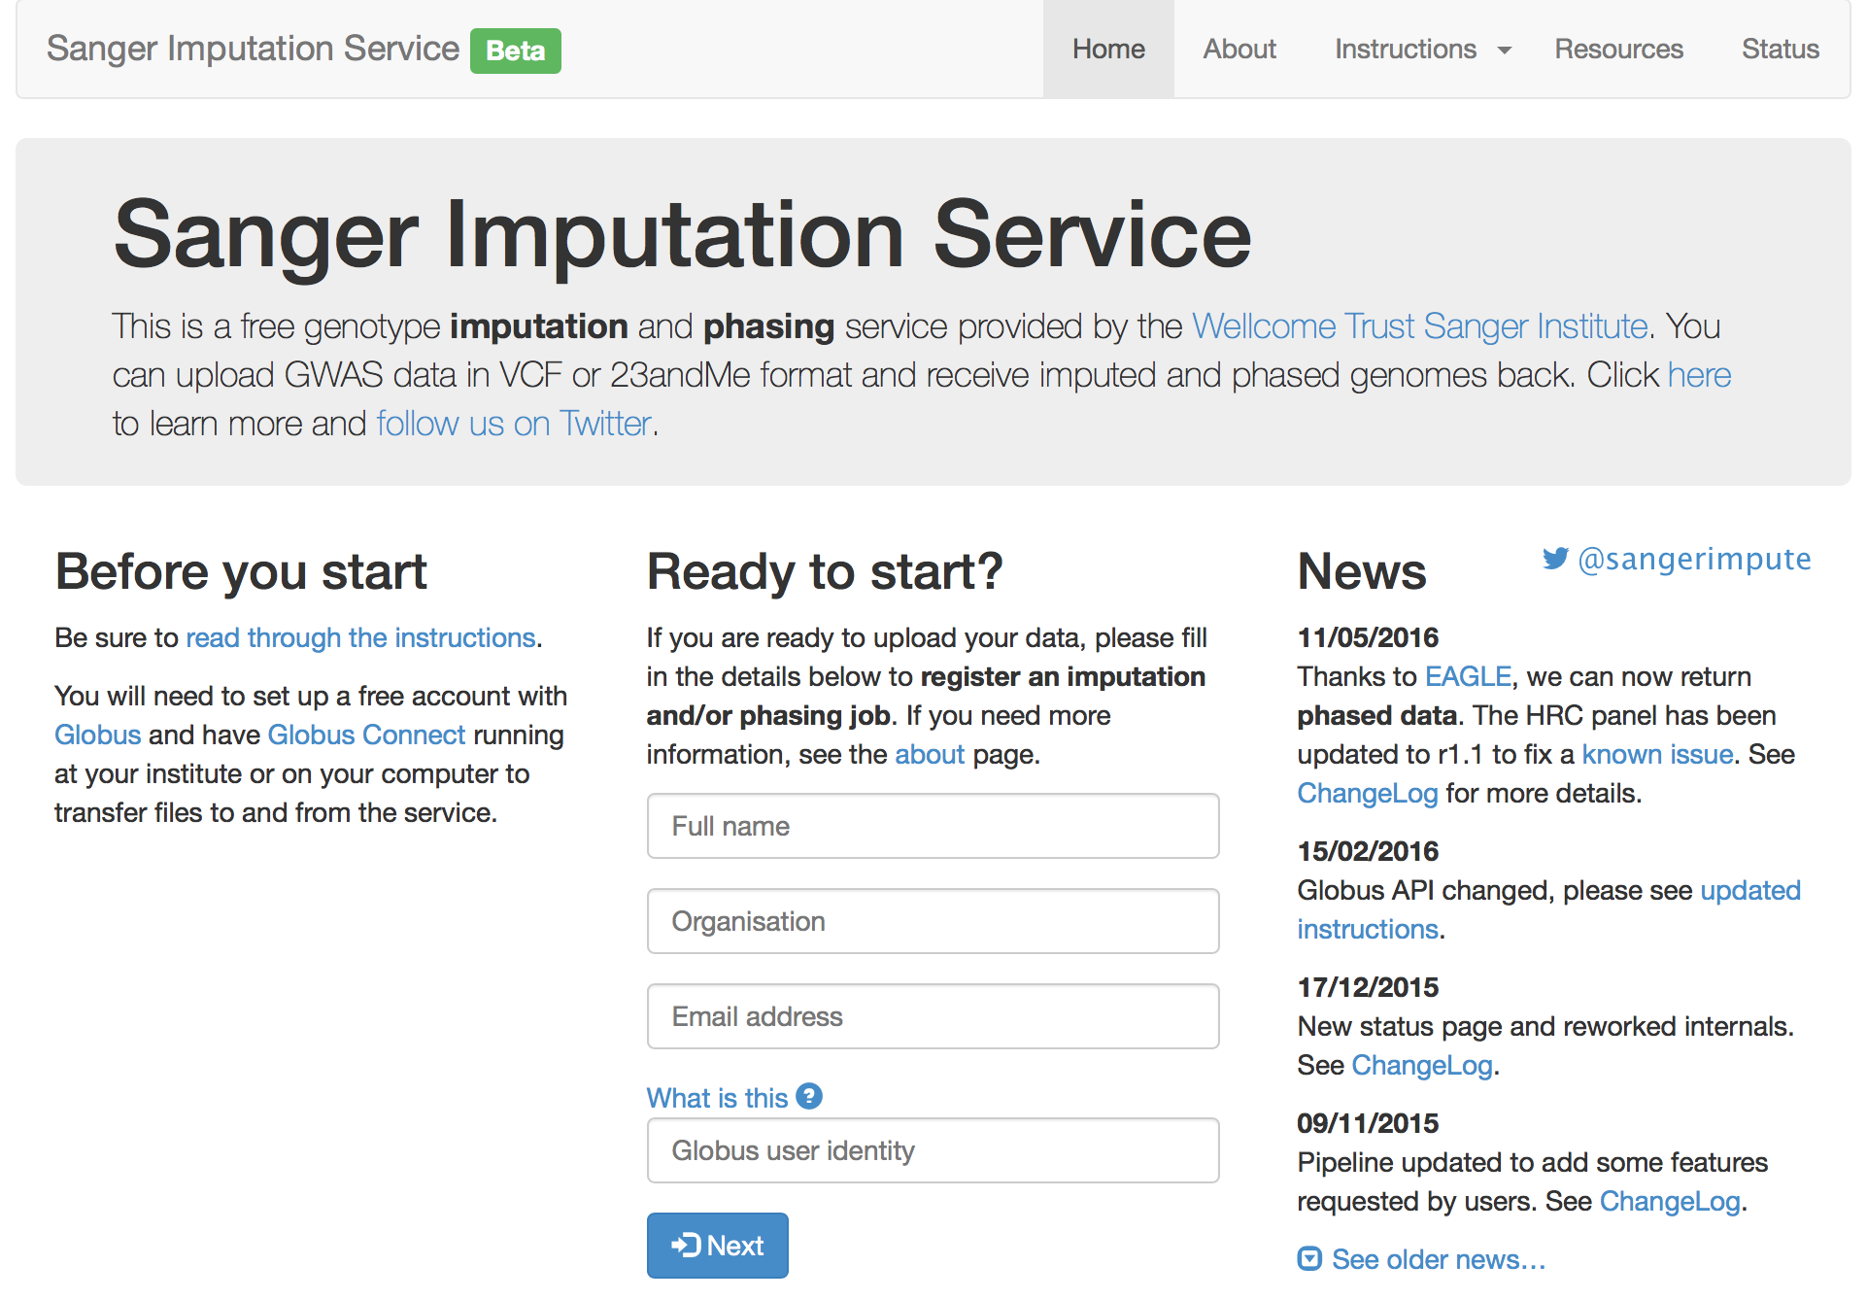
Analysis Workflow Integration: Wellcome Sanger
Notes:
Have people actually done this in the wild? Why yes they have…

Slide 46
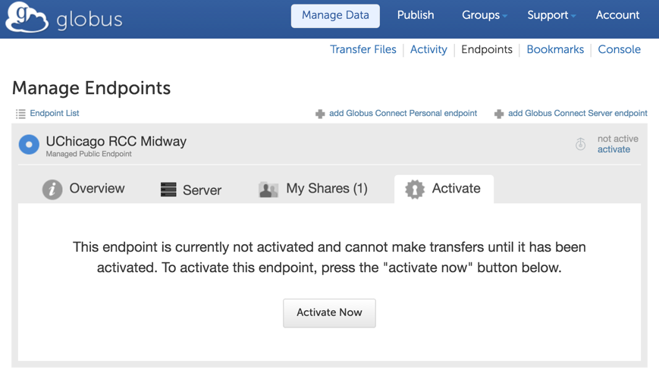
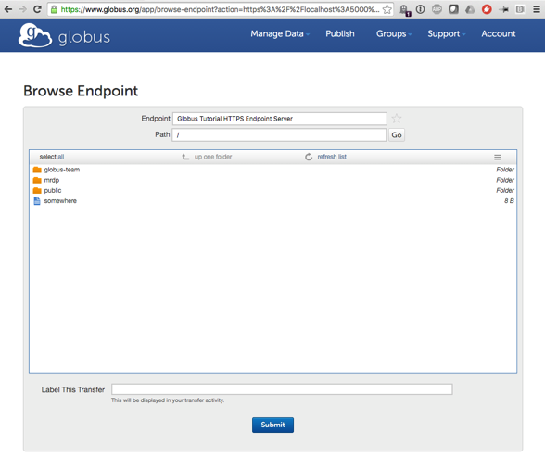
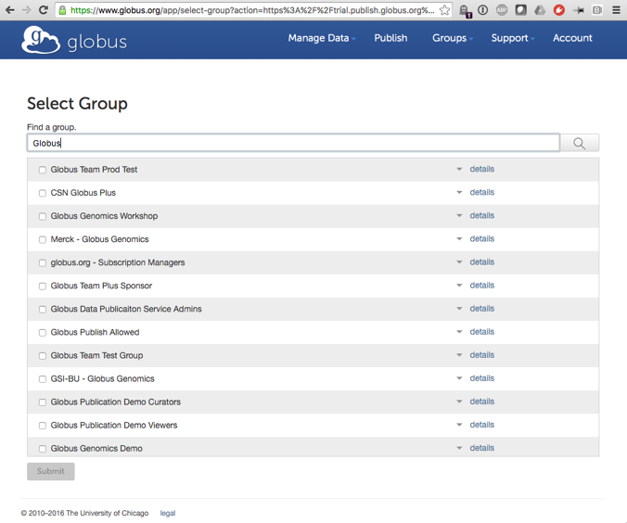
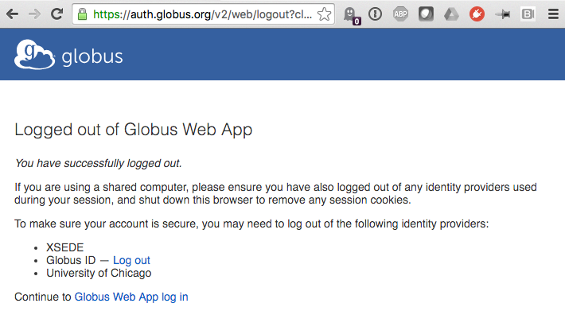
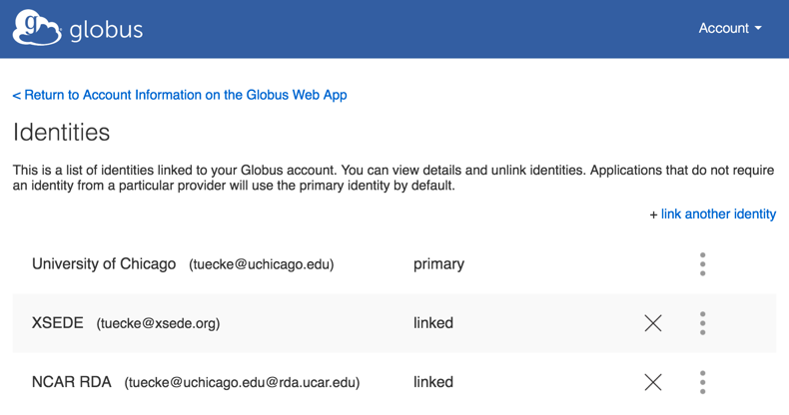
Globus Helper Pages
Globus pages designed for use by your web apps
Browse Endpoint
Activate Endpoint
Select Group
Manage Identities
Manage Consents
Logout
docs.globus.org/api/helper-pages
Notes:
One last thing we’ve done to make life easier as you build your web apps.

Slide 47
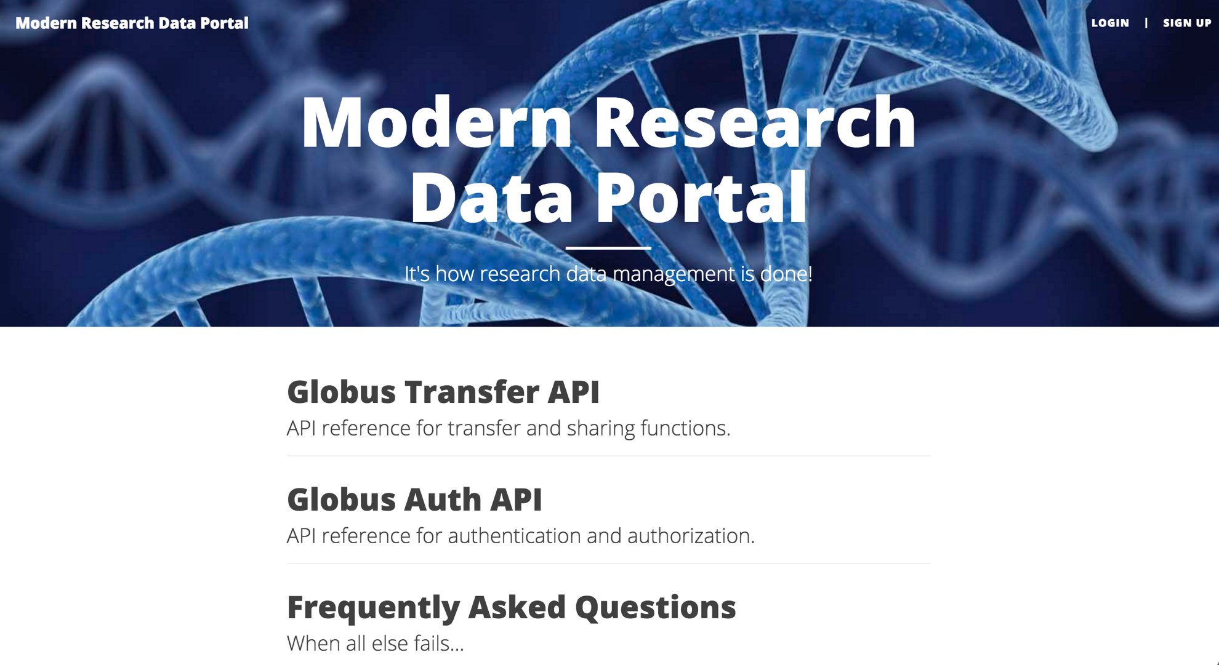
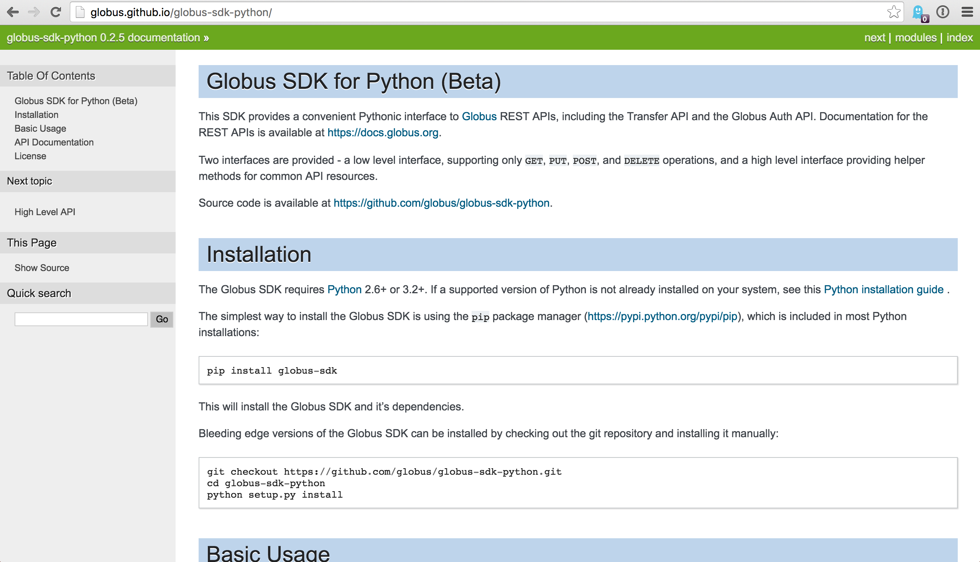
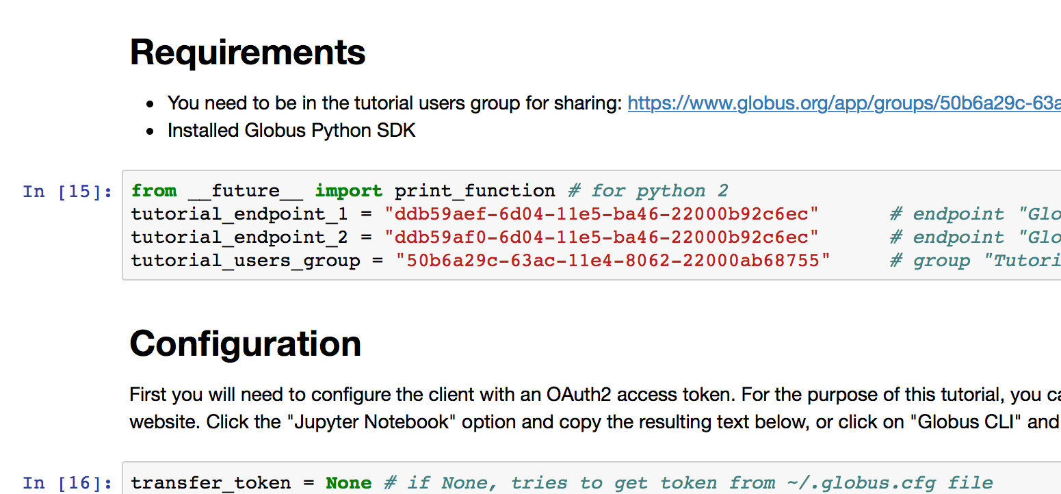
Globus PaaS developer resources
Python SDK
Sample
Application
Jupyter Notebook
docs.globus.org/api
github.com/globus
Notes:
Just a reminder of the resources we’ve made available to you and your developers.

Slide 48
Automating Research Data Workflows
GlobusWorld 2018
Rachana Ananthakrishnan rachana@globus.org

Slide 49
Data replication
Recurring transfers with sync option
Copy /ingest
Daily @ 3:30am
For backup: initiated by user or system back up
Automated transfer of data from science instrument

Slide 50
Staging data with compute jobs
Stage data in or out as part of the job
Transfer task is submitted when the job is run
Endpoint might not be activated at that time
Two approaches:
User adds directives to job submission script
An application manages staging of data for user

Slide 51
Automation from portals/gateways
Portal/science gateway submits a transfer of compute results as the user
Portal/science gateway monitors users transfer, and initiates processing or backup of data.

Slide 52
Relevant Platform Capabilities

Slide 53
Native apps
Examples (any client that cannot keep a secret)
Command line, desktop apps
Mobile apps
Jupyter notebooks
Native app is registered with Globus Auth
Not a confidential client
Native App Grant is used
Variation on the Authorization Code Grant
Globus SDK:
To get tokens: NativeAppAuthClient
To use tokens: AccessTokenAuthorizer

Slide 54
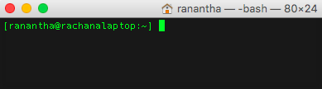
Native App grant
3. Authenticate and consent
Globus Auth (Authorization Server)
Browser
1. Run application
4. Auth code
2. URL to authenticate
5. Register auth code
6. Exchange code
Native App (Client)
7. Access tokens
8. Authenticate with access tokens to invoke transfer service as user
Globus Transfer (Resource Server)

Slide 55
Refresh tokens
For “offline services”
e.g., transfer working on your behalf even when you are offline
Refresh tokens issued to client, in particular scope
Client uses refresh token to get access token
Refresh token good for 6 months after last use
Consent rescindment revokes resource token
Globus SDK:
To get token: ConfidentialAppClient or NativeAppClient
To use tokens: RefreshTokenAuthorizer

Slide 56
Refresh tokens
3. Authenticate and consent
Globus Auth (Authorization Server)
1. Run application
Browser
4. Auth code
2. URL to authenticate
5. Register auth code
6. Exchange code, request refresh tokens
7. Access tokens and refresh tokens
Native App (Client)
9. Exchange refresh token for new access tokens
10. Access tokens
Globus Transfer (Resource Server)
8. Store refresh tokens
11. Authenticate with access tokens to invoke transfer service as user

Slide 57
Native App/Refresh Tokens Sample Code
github.com/globus/native-app-examples
See README for installation
./example_copy_paste.py
Copy paste code to the app
./example_copy_paste_refresh_token.py
Stores refresh token locally, uses it to get new access tokens
Notes:
RA: Remove

Slide 58
Using Globus CLI for automation

Slide 59
Globus CLI
It’s a native application distributed by Globus
Easy install and updates
Command “globus login” gets access tokens and refresh tokens
Stores the token locally (~/.globus.cfg )
All interactions with the service use the tokens
Tokens for Globus Auth and Transfer services
Command globus logout deletes those
See https://docs.globus.org/cli/examples/

Slide 60
UUIDs everywhere
UUIDs for endpoint, task, user identity, groups..
Use search/list options
get-identities for identity username to UUID
$ globus endpoint search "Globus Tutorial Endpoint”
$ globus task list
$ globus get-identities rachana@globus.org

Slide 61
Batch Transfers
A transfer task can only be from one source to one destination, but can have any number of files
Provide input from local files
Move files listed in files.txt from Tutorial Endpoint 1 to Tutorial Endpoint 2
$ globus transfer $ep1:/share/godata/ $ep2:~/ \ --batch --label "CLI Batch" < files.txt
Notes:
$ ep1=ddb59aef-6d04-11e5-ba46-22000b92c6ec $ ep2=ddb59af0-6d04-11e5-ba46-22000b92c6ec

Slide 62
Submission commands
Safe resubmissions
Applies to all tasks (transfer and delete)
Get a task UUID, use that in submission
$ globus task generate-submission-id
--submission-id option in transfer
Task wait
useful for scripting conditional on transfer task status

Slide 63
Parsing CLI output
Default is text
$ globus endpoint search --filter-scope my-endpoints
JSON: --format JSON
$ globus endpoint search --filter-scope my-endpoints --format JSON
Extract specific : --jmespath <expression>
$ globus endpoint search --filter-scope my-endpoints --jmespath 'DATA[0].[id, display_name]’

Slide 64
Turn off notifications
Turn off emails sent for the task
Useful when an application manages tasks for a user
All notifications can be turned off:
--notify off
Select type of notification to turn off:
--notify failed, inactive

Slide 65
Permission management
Set and manage permissions on shared endpoint
Need access manager role
$ globus endpoint permission create --permissions r --identity greg@globus.org $share:/forGreg/
$ globus endpoint permission list $share
$ globus endpoint permission delete $share 9edd3956-4736-11e8-8ed2-0a6d4e044368

Slide 66
Automation with CLI
A script that uses the CLI to transfer data repeatedly via task manager/cron
Interactions are as user: both for data access and to Globus services
CLI commands used in the job submission script
CLI is installed on head node
User runs ”globus login”, the tokens are stored in user’s home directory
Tokens accessible when the job runs and submits stage in or stage out tasks
Use the –skip-activation-check to submit the task even if endpoint is not activated at submit time

Slide 67
Automation with portals
Portal needs to act as the user
User grants “offline” access to the portal
Refresh tokens are obtained for each user by the portal and stored
The portal’s client id and secret, and refresh tokens are needed to obtain new access tokens
Typically state maintained in the portal about transfer initiated or to be managed (task id)

Slide 68
Walkthrough
Sample script that use sync option to transfer files between endpoints
https://github.com/globus/automation-examples/blob/master/cli-sync.sh
Sample app that uses Python SDK for the same
https://github.com/globus/automation-examples/blob/master/globus_folder_sync.py

Slide 69
Jupyter + Globus: The Foundation for Interactive Data Science
Rick Wagner
rick@globus.org
April 26, 2018

Slide 70
Agenda
JupyterHub Background
How to Secure JupyterHub with Globus Auth
Accessing Web Services via Jupyter Notebooks
More Information

Slide 71
JupyterHub Background
How to Secure JupyterHub with Globus Auth
Accessing Web Services via Jupyter Notebooks
More Information

Slide 72

JupyterHub: A multi-user Hub, spawns, manages, and proxies multiple instances of the single-user Jupyter notebook server.
JupyterHub can be used to serve notebooks to a class of students, a corporate data science group, or a scientific research group.
JupyterHub Docs

Slide 73
Basic Jupyter Components
JupyterHub components
Multi-user Hub
Configurable http proxy
Multiple single-user Jupyter notebook servers
Python
R
Etc.

Slide 74
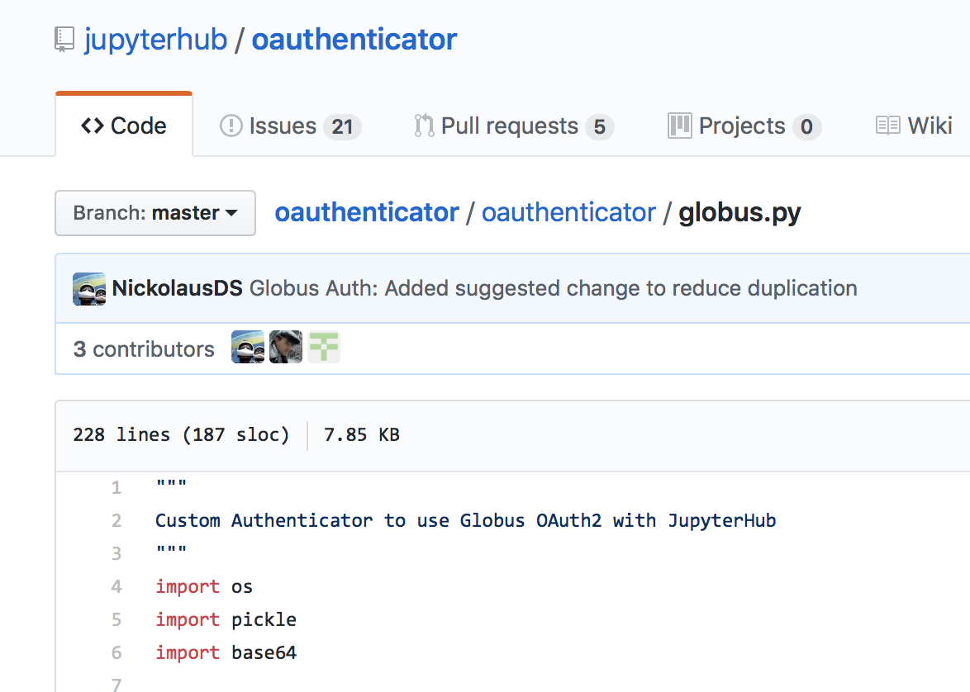
Securing JupyterHub with Globus Auth
Globus OAuth plugin
Existing OAuth framework
Documentation covers app registration and config
Can restrict identity provider
Custom scopes
Tokens passed into notebook environment
JupyterHub OAuthenticator

Slide 75
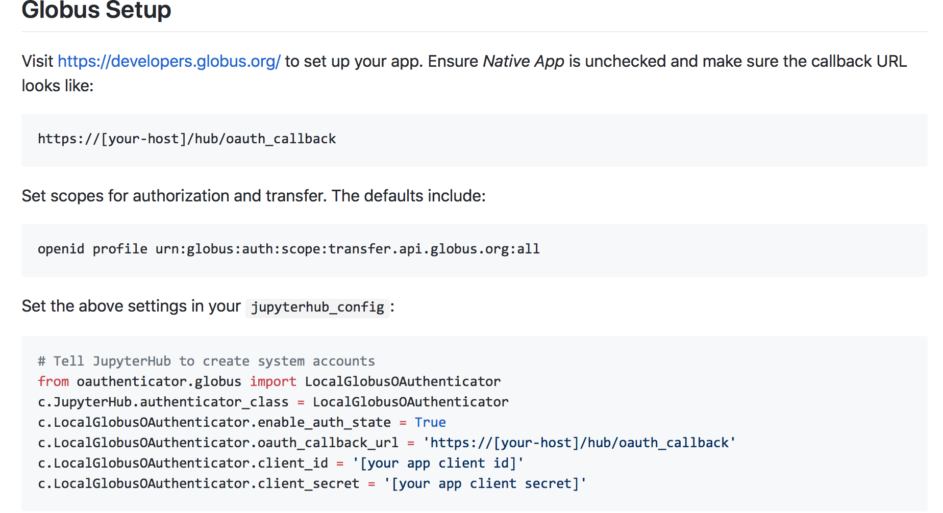
Securing JupyterHub with Globus Auth
https://github.com/jupyterhub/oauthenticator#globus-setup

Slide 76
Tokens and Jupyter Notebooks
Tokens are passed back to the JupyterHub server
Stored as a secure attribute in database
Passed into Notebook Server environment
Can be pull into notebook or other code
Used to talk to Globus and other REST APIs secured with Globus Auth

Slide 77

Tokens and Jupyter Notebooks
Login
Bearer a45cd…
REST APIs
REST APIs
REST APIs
{ “tokens”:…
{“tokens”:…

Slide 78
Tutorial
What we’re going to do:
Login into our GlobusWorld JupyterHub
Launch (spawn) Notebook Server
Get tokens
Access some Globus APIs
Download some data
Plot it
PUT it on an HTTPS endpoint
Zero to JupyterHub: Fast JupyterHub on Kubernetes https://zero-to-jupyterhub.readthedocs.io

Slide 79
https://jupyter.demo.globus.org/
Login to Start Tutorial

Slide 80
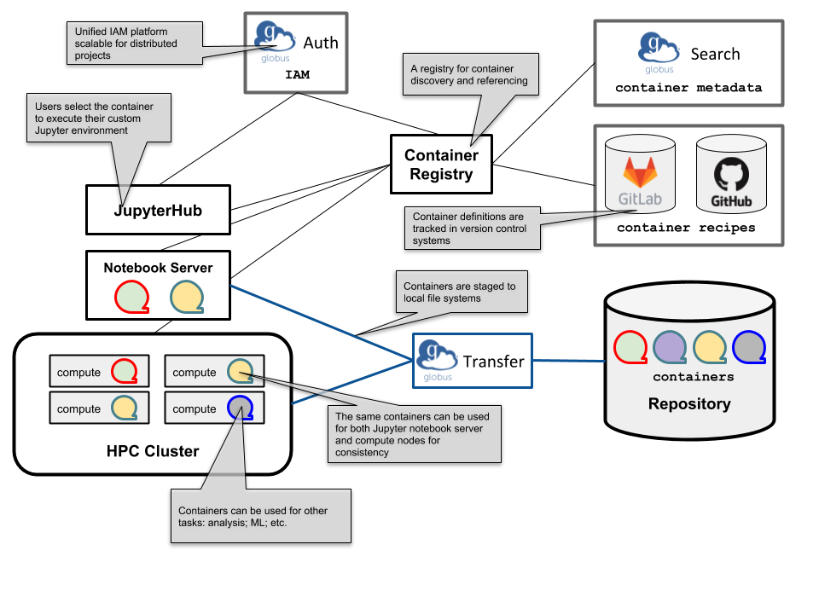
Future Goals: Containers

Slide 81
Support resources
Globus documentation: docs.globus.org
Helpdesk and issue escalation: support@globus.org
Customer engagement team
Globus professional services team
Assist with portal/gateway/app architecture and design
Develop custom applications that leverage the Globus platform
Advise on customized deployment and integration scenarios
Notes:
When all else fails.

Slide 82

Globus as PaaS
Globus Transfer API
…
Globus Connect
Data Publication & Discovery
File Sharing
File Transfer & Replication
Globus Auth API
(Group Management)
Integrate file transfer and sharing capabilities into scientific web apps, portals, gateways, etc.
Use existing institutional ID systems in external web applications

Slide 83
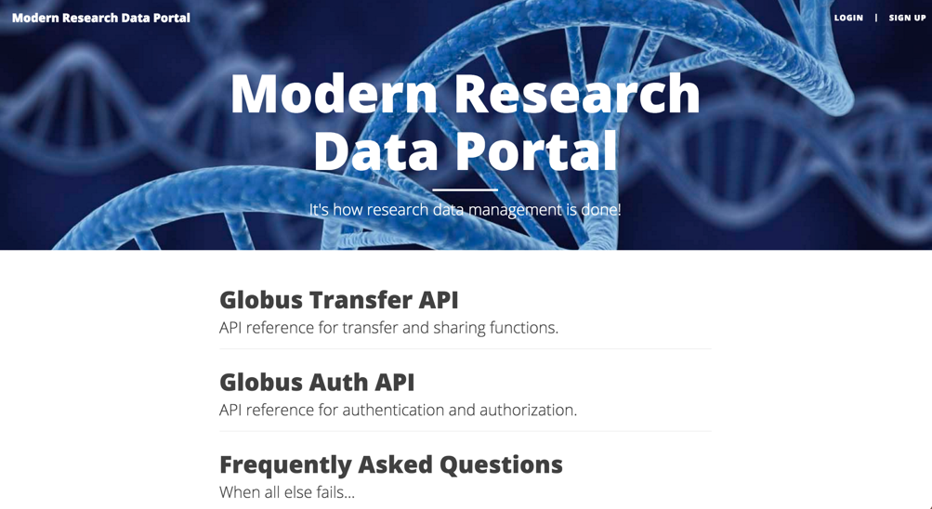


Globus PaaS developer resources
Python SDK
Sample
Application
Jupyter Notebook
docs.globus.org/api
github.com/globus

Slide 84






Thank you to our sponsors…
U.S. DEPARTMENT OF
ENERGY

Slide 85
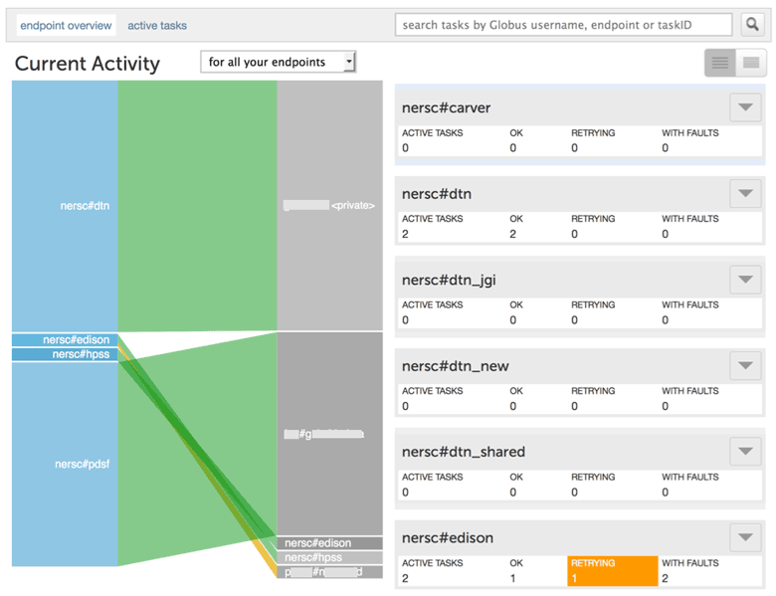
Globus sustainability model
Standard Subscription
Shared endpoints
Data publication
Management console
Usage reporting
Priority support
Application integration
HTTPS support (coming soon)
Branded Web Site
Premium Storage Connectors
Alternate Identity Provider (InCommon is standard)

Slide 86
Thank you to our users…
48 most server endpoints at a single
organization
384 PB
transferred
64 billion tasks processed
76,000
registered users
500 100TB+ users
14,000
active users
3 months
longest running managed transfer
10,000 active endpoints
350+ federated identities
1 PB largest single transfer to date
5,000 active shared endpoints
99.5%
uptime
Notes:
Auth, transfer, sharing, publication

Slide 87























Our supporters

Slide 88
Join the Globus community
Access the service: globus.org/login
Create a personal endpoint: globus.org/app/endpoints/create-gcp
Documentation: docs.globus.org
Engage: globus.org/mailing-lists
Subscribe: globus.org/subscriptions
Need help? support@globus.org
Follow us: @globusonline

Slide 89
Help us get the word out!
“…, and file sharing with Globus.”
Share your experiences!
Contribute to our Usage Brief Library
Add a slide or logo in event talks (we can help!)
Mention Globus in news articles or interviews
Tag us in posts about projects that use Globus
Acknowledge Globus in your journal articles
Why?
Give your peers new ideas on how to use Globus
Help us grow the user community
“…with Globus for data transfer.”
“We used Globus for…”
“I needed Globus to…”
“...and Globus.”
“#ALCF #ORNL #theNCI #CANDLE #globusonline”
“…using tool x, tool y, Globus, technology z…

